Slide 1

Bank Loan Case Study
Submitted by : Ajith KS

Slide 2
Project Description
The project focuses on analyzing patterns in bank loan data to prevent the rejection of qualified loan applicants.
The insights derived will assist bank managers and stakeholders in identifying applicants likely to face difficulties in repaying their installments.
As Data Analysts, we have been provided with a dataset comprising loan applicant details and queries.
Our responsibility involves analyzing the dataset and providing insights to address specific inquiries.
Python programming language will be utilized for data pre-processing and exploratory data analysis (EDA) to extract the necessary insights.

Slide 3

Approach
Received a dataset containing information on loan applications, including applicant income, credit amount, disposable income, car ownership, home ownership, etc.
Conducted initial exploration of the dataset to gain a comprehensive understanding.
Performed Data Pre-Processing, addressing missing data, errors, outliers, and duplicates as necessary.
Initiated Exploratory Data Analysis (EDA) tailored to specific queries, utilizing graphical representations for clarity.
Derived conclusions and insights from the filtered data and visualizations.
Preparing a detailed report summarizing the findings and insights, to be delivered to the relevant department.

Slide 4


Tech Stack Used
Python
Jupyter Notebook

Slide 5

Data set information
We're equipped with two distinct datasets crucial for our analysis:
Application Data: This comprehensive dataset comprises 49,999 rows and a vast array of 122 columns, providing a detailed snapshot of current loan applications.
Previous Application Data: With an identical size of 49,999 rows, this dataset offers insights into historical loan applications through its 37 columns, enriching our understanding of past trends and behaviors.
These datasets serve as the cornerstone of our analytical endeavors, offering a wealth of information to drive insightful decision-making.

Slide 6

Identify Missing Data and Deal with it Appropriately
The strategy to manage missing and irrelevant data involves two key steps:
Removing Columns with High Missing Data: Columns with a significant portion of missing data are identified and subsequently dropped from the dataset. This action ensures that our analysis focuses on variables with sufficient information, reducing the complexity of handling missing values.
Eliminating Irrelevant Columns: Columns deemed irrelevant to our analysis objectives are also eliminated. By pruning away extraneous variables, we streamline the dataset, making it more manageable and enhancing the relevance of the remaining data for our analytical tasks.
This approach aims to simplify the dataset and facilitate efficient data handling, enabling us to derive meaningful insights effectively.

Slide 7

Application data
We applied a systematic approach to refine the dataset:
Handling Missing Values: Removed 50 columns with over 30% missing values to streamline the dataset.
Column Selection: Retained only the essential 13 columns relevant to our analysis objectives.
Feature Engineering: Converted DAYS_EMPLOYED and DAYS_BIRTH to years, representing Experience and Age respectively.
Final Dataset: Through these transformations, we curated a final dataset consisting of 49,999 rows and 15 columns, optimized for our analytical endeavors.

Slide 8
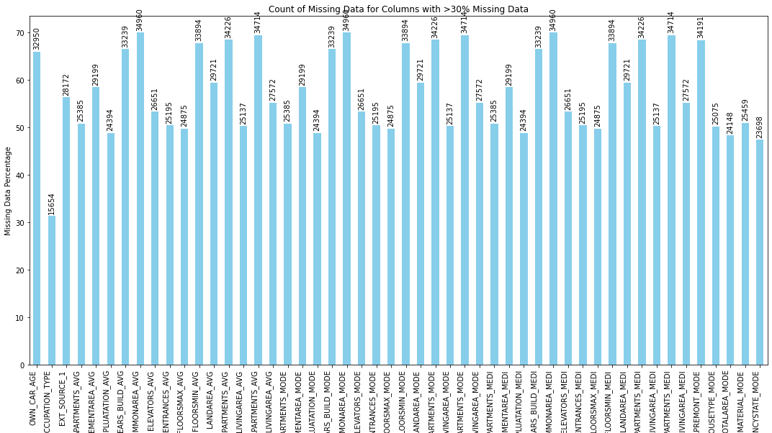
Distribution of Missing Values in Application Data

Slide 9
Previous Application data
We employed a methodical process to refine the dataset:
Handling Missing Values: Identified and eliminated 11 columns with over 20% missing values to enhance data integrity.
Column Selection: Exercised discretion to retain 9 essential columns aligned with our analysis objectives.
Streamlining Through Selection: Ensured dataset focus by retaining only the most relevant variables.
Optimized Dataset: The final dataset consists of 49,999 rows and 9 columns, tailored for precise analysis and insights extraction.

Slide 10
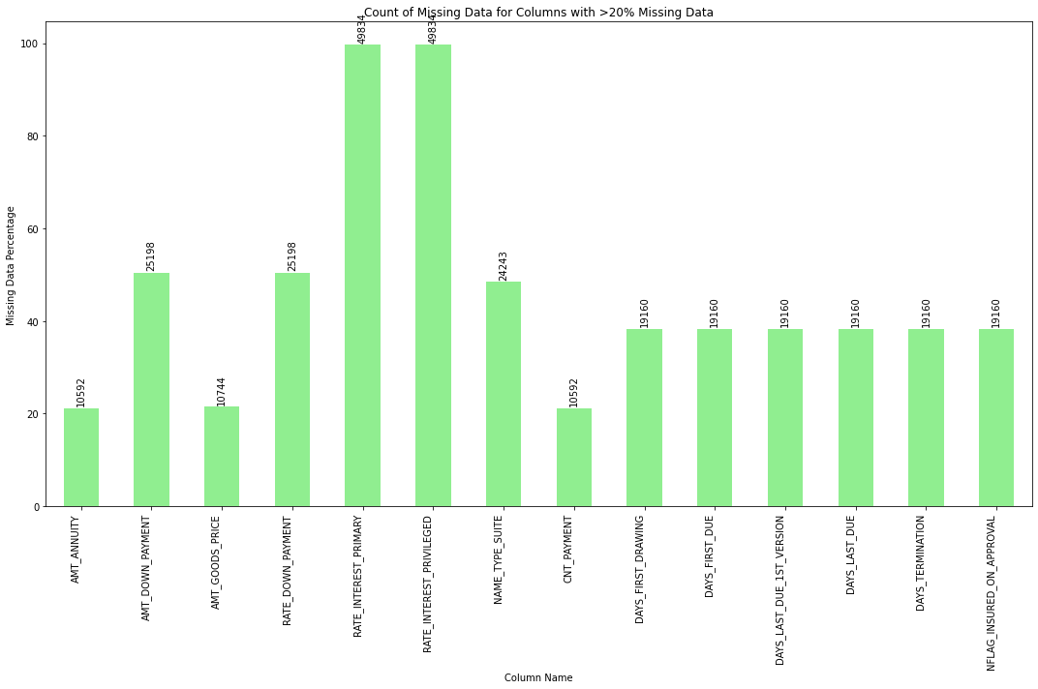
Distribution of missing values in Previous Application data

Slide 11
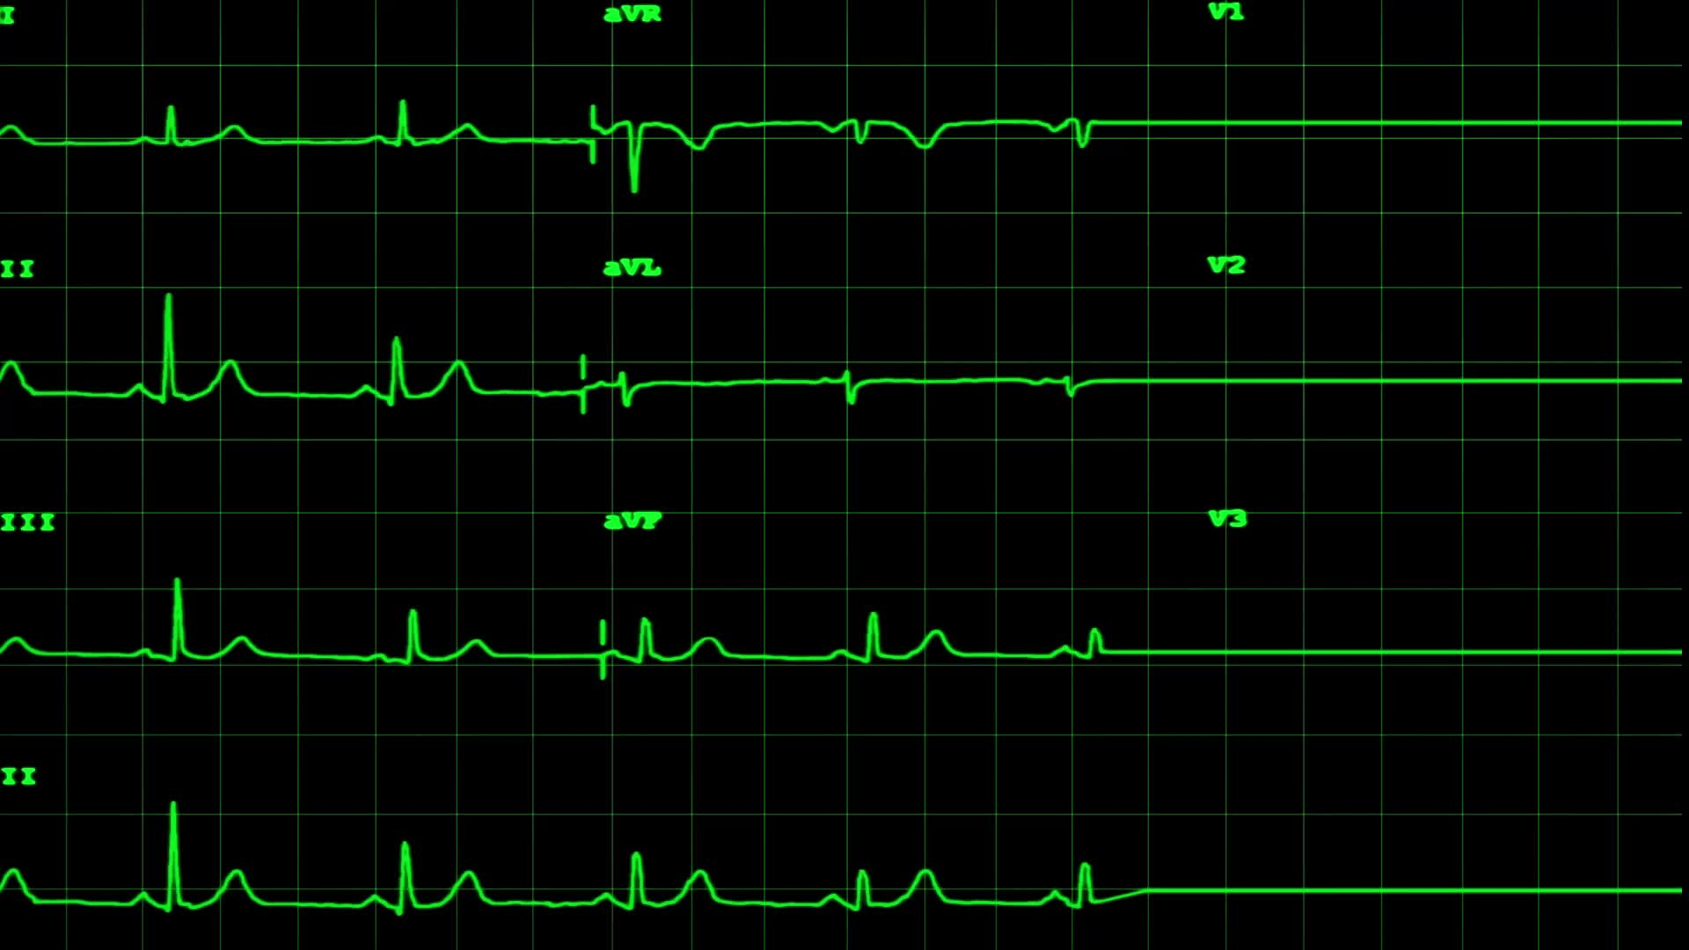
Identify Outliers in the Dataset
Here's a breakdown of the steps taken:
Numerical Data Summary:
Count: Determined the number of observations in the cleaned dataset.
Mean: Calculated the average value of the numerical data.
Standard Deviation: Measured the dispersion of the numerical data around the mean.
Minimum: Identified the smallest value in the dataset.
25%, 50%, 70% Percentiles: Examined key percentiles to understand data distribution.
Maximum: Identified the largest value in the dataset.
Outlier Detection:
Identified potential outliers by analyzing deviations from the mean and interquartile range.
Boxplots for Visualization:
Utilized boxplots to visually represent the distribution of numerical data.
Enhanced understanding of data spread, central tendency, and presence of outliers.
This comprehensive approach enables a thorough exploration of the numerical data, from summary statistics to outlier detection and visualization using boxplots, facilitating deeper insights into the dataset's characteristics.

Slide 12
Numerical Data Summary of Application data
 | AMT_INCOME_TOTAL | AMT_CREDIT | AMT_ANNUITY | AMT_GOODS_PRICE | Age | Experience
count | 49999.00 | 49999.00 | 49998.00 | 49961.00 | 49999.00 | 49999.00
mean | 170767.60 | 599700.60 | 27107.38 | 539060.00 | 43.87 | 183.87
std | 531819.10 | 402415.40 | 14562.94 | 369853.30 | 11.94 | 380.45
min | 25650.00 | 45000.00 | 2052.00 | 45000.00 | 21.03 | 0.00
25% | 112500.00 | 270000.00 | 16456.50 | 238500.00 | 33.89 | 2.55
50% | 145800.00 | 514777.50 | 24939.00 | 450000.00 | 43.07 | 6.07
75% | 202500.00 | 808650.00 | 34596.00 | 679500.00 | 53.78 | 15.66
max | 117000000.00 | 4050000.00 | 258025.50 | 4050000.00 | 68.95 | 999.98

Slide 13
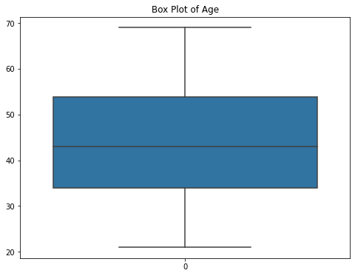
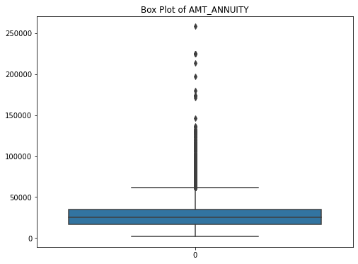
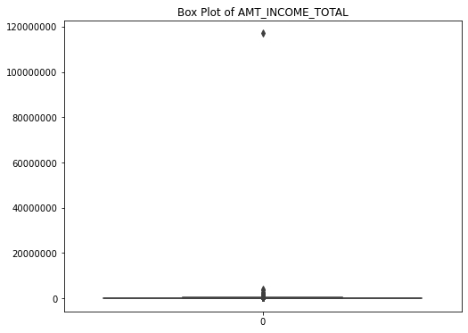
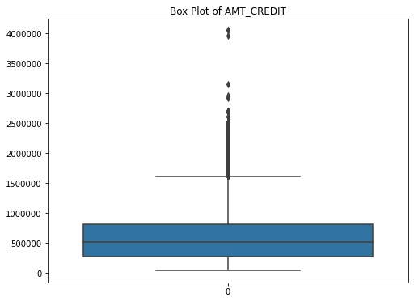
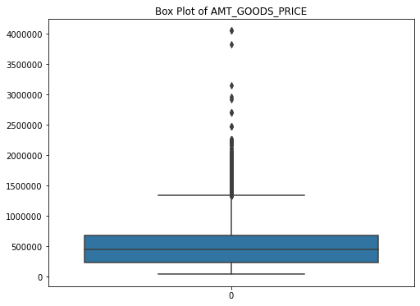
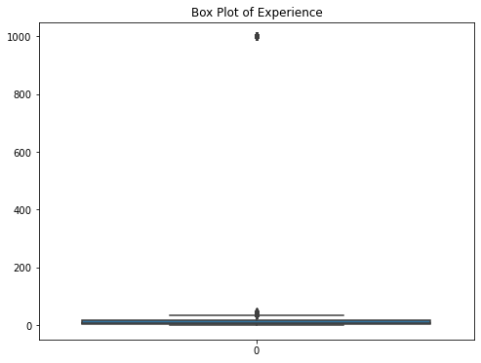
Outlier distribution

Slide 14
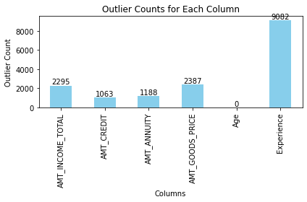
Summary of Outlier Analysis:
Observation: Box plots clearly indicate the presence of outliers in all columns except for Age.
Outlier Detection: Employed the Interquartile Range (IQR) method to identify outliers.
Results: Following the application of the IQR method, it was determined that 13,214 rows contained outliers.
Insight: Outliers can significantly impact the accuracy of statistical analysis and model performance. Further investigation and potentially outlier treatment strategies may be necessary to mitigate their influence on the analysis results.

Slide 15

Analyze Data Imbalance
Repayment Difficulty Analysis:
Using the target column, identify users who have difficulties in repayment history.
Calculate the proportion of users with repayment difficulties.
Graph Visualization: Utilize a graph to visually represent the proportion of users with repayment difficulties.
Choose an appropriate type of graph to effectively convey the information.
This approach combines data analysis with visualization to provide insights into the proportion of users experiencing repayment difficulties, facilitating a comprehensive understanding of the dataset's characteristics in this aspect.

Slide 16
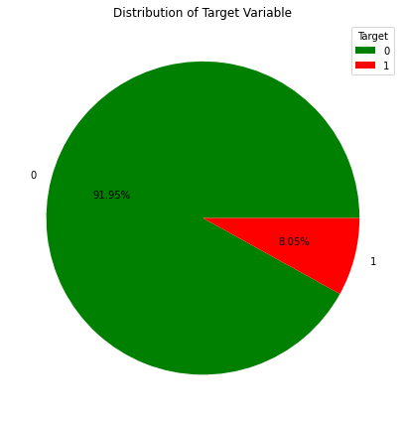
Distribution of Target users
In our analysis, we classified users based on their repayment behavior, where 0 represents defaulters and 1 represents timely payments. Remarkably, our findings reveal that the overwhelming majority of users demonstrate commendable financial discipline, reflected by their timely payment behavior (labeled as 1). Only a negligible proportion is classified as defaulters (labeled as 0). This stark contrast is eloquently depicted in our pie chart, emphasizing the dominance of the 'Timely Payments' segment and underscoring the financial resilience of our user base.

Slide 17

Perform Univariate, Segmented Univariate, and Bivariate Analysis
Categorical Analysis:
Segmented dataset by repayment behavior (0 for defaulters, 1 for timely payments).
Bar plots highlight categorical variable differences between defaulters and timely payers.
Numerical Analysis:
Histograms unveil numerical variable distributions.
Clustered bar charts reveal categorical variable impact on repayment behavior.
This approach delivers actionable insights for decision-making.

Slide 18
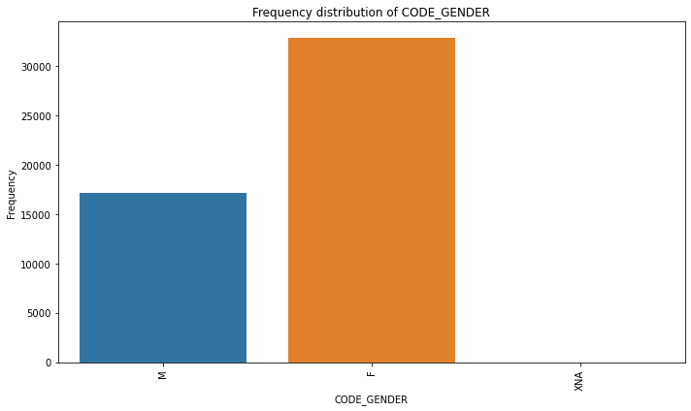
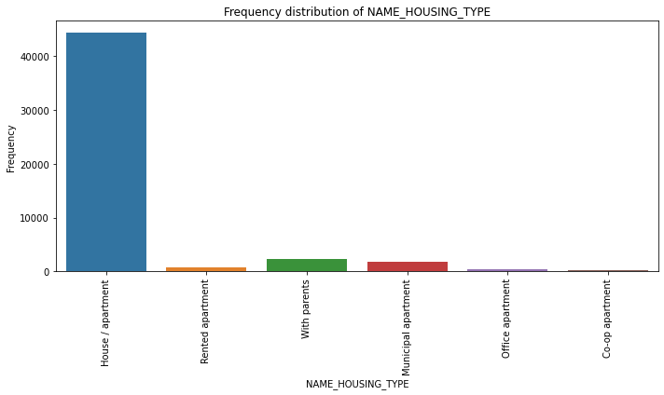
Distribution of Univariate analysis
Female applicants dominate the loan application pool
The data indicates that most applicants reside in their own house or apartment, highlighting a preference for homeownership among loan applicants

Slide 19
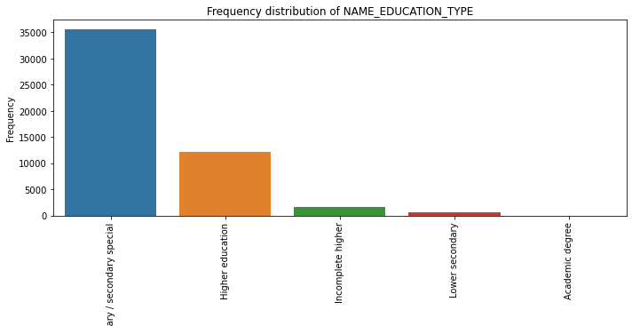
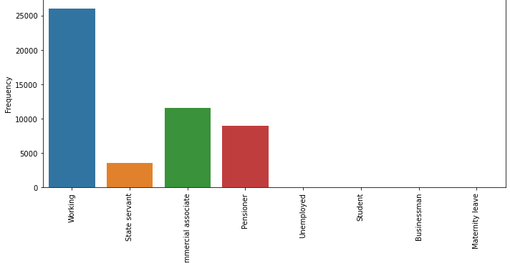
Most applicants possess only a secondary level of education.
Most applicants are employed professionals.

Slide 20
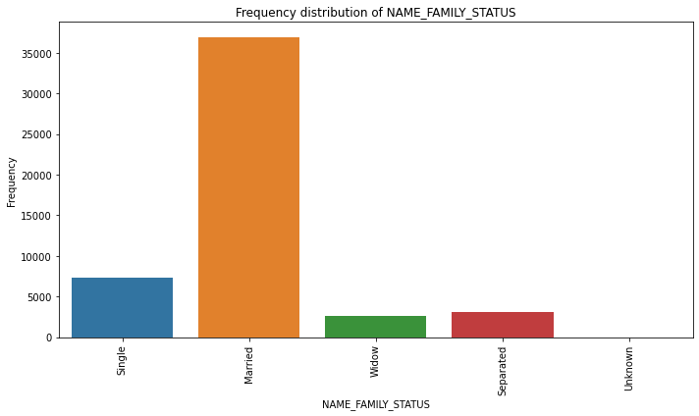
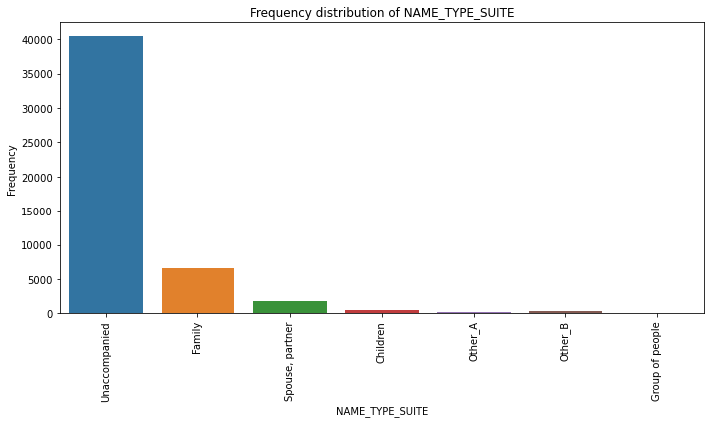
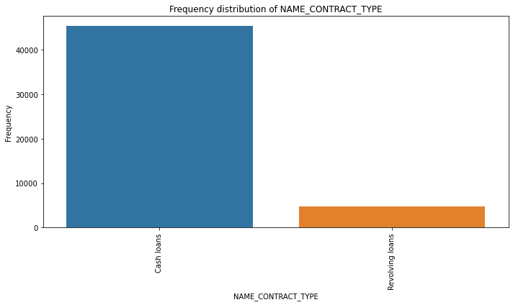
Most applicants are married
Most applicants are found to be living alone
Cash loans show higher demand compared to revolving credit.

Slide 21
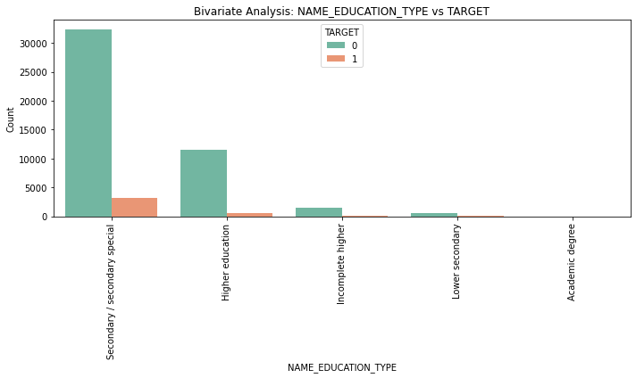
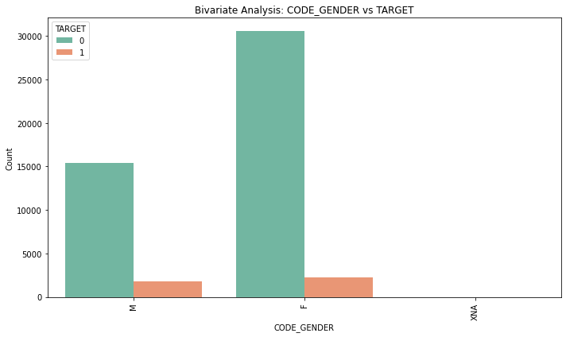
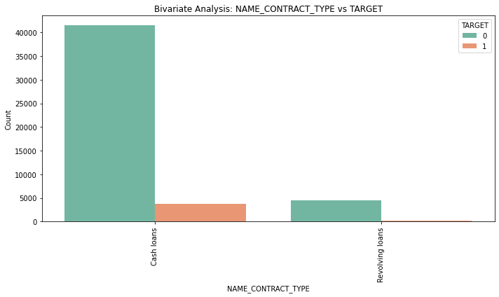
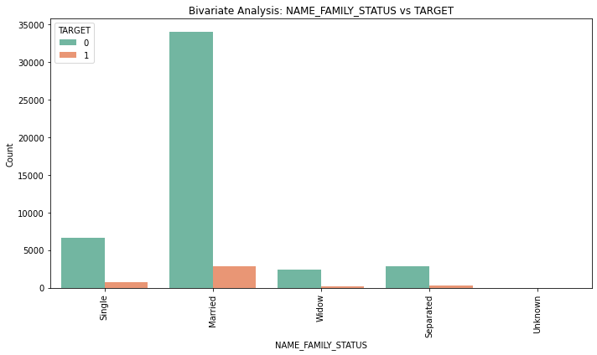
Bivariate analysis
Target variable 1 denotes defaulters, while 0 signifies timely payments.
An intriguing finding reveals a direct proportional relationship between the number of timely payments and the number of defaulters.

Slide 22
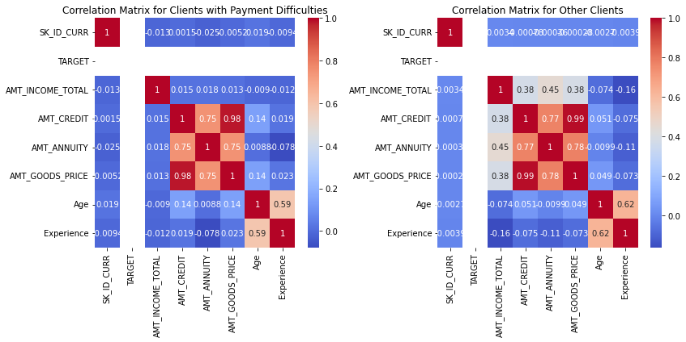
Identify Top Correlations for Different Scenarios
Key points revealed by the heatmap analysis are:
There exists a strong correlation between AMT_GOODS_PRICE and AMT_CREDIT.
Similarly, AMT_GOODS_PRICE shows a significant correlation with AMT_ANNUITY.
Additionally, there is a notable correlation between AMT_CREDIT and AMT_ANNUITY.

Slide 23

Result
This project has been instrumental in illustrating the pivotal role of Data Analytics in the realm of Bank Loan Analysis, underscoring its capacity to furnish invaluable insights crucial for informed decision-making. Through meticulous analysis, I gained insights into the pivotal features influencing the prediction of loan defaulters, elucidating correlations among diverse variables such as income amount, loan amount, and personal belongings details.
Moreover, I honed my skills in Data Preprocessing, encompassing tasks like Data Cleaning, handling Outliers, and Feature Engineering, which are integral for ensuring the integrity and efficacy of analytical outcomes. Armed with these insights, I am well-equipped to effectively communicate findings to relevant stakeholders, empowering them to formulate judicious, data-driven strategies.
Additionally, this project has served as a profound learning experience, deepening my understanding of Python and its myriad functionalities, thereby enhancing my proficiency in leveraging it for analytical pursuits.

Slide 24
Link to GitHub repo

